Slide 1
Current Rental Market Snapshot
For
Downtown Sacramento
M&M Properties | 1545 River Park Dr.#100 | Sacramento CA 95815 | 916.500.8188

Slide 2
Sacramento Rental Market and Investment Climate
Rental Market
The Sacramento rental market has been relatively stable in recent years, with steady demand and moderate rent increases. While the market has seen some fluctuations due to economic factors and housing trends, it has generally remained a favorable location for renters.
Demand: Sacramento's growing population and strong job market have contributed to consistent demand for rental properties.
Rent Prices: While rent prices have risen over time, they generally remain lower than many other major California cities.
Inventory: The availability of rental units can vary depending on the specific neighborhood and property type, but there is generally a sufficient supply to meet demand.
Rental Investment Climate
Sacramento has been a popular choice for real estate investors, including those focusing on rental properties. Here's a breakdown of the investment climate:
Cap Rates: While cap rates can fluctuate, Sacramento generally offers competitive returns for rental property investors.
Appreciation: The city's strong job market and growing population have contributed to steady property value appreciation.
Tenant Demand: The consistent demand for rental housing in Sacramento provides a stable income stream for landlords.
Market Stability: While the real estate market is subject to economic cycles, Sacramento has historically shown resilience and stability.
Factors to Consider:
Neighborhoods: The choice of neighborhood can significantly impact rental income, property values, and tenant demand.
Property Type: Different property types (e.g., single-family homes, apartments, condos) have varying investment characteristics.
Market Research: Conducting thorough market research is essential for making informed investment decisions.
Regulations: Understanding local regulations and zoning laws is crucial for rental property owners.
Overall, Sacramento's rental market and investment climate offer a favorable environment for those considering real estate investments. However, it's important to conduct thorough research and consult with real estate professionals to assist you in making informed decisions based on your specific goals and financial situation.

Slide 3
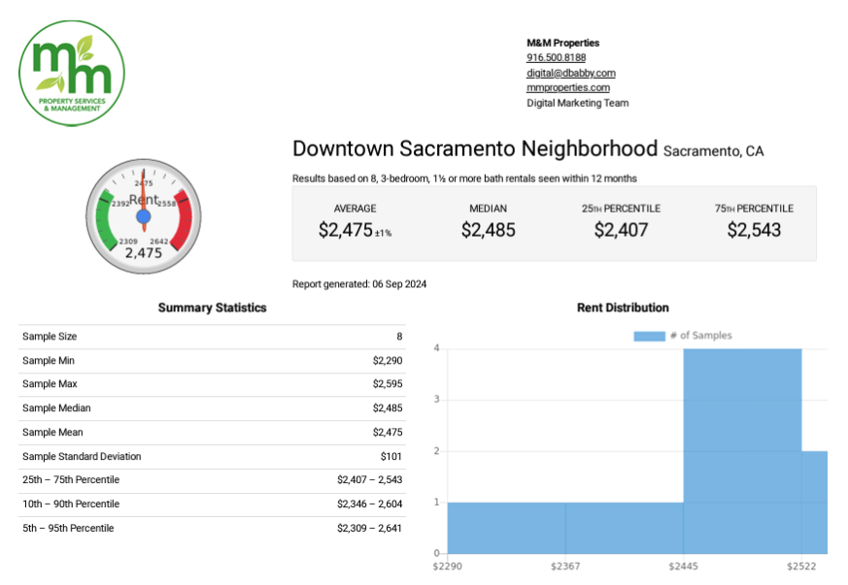

Slide 4
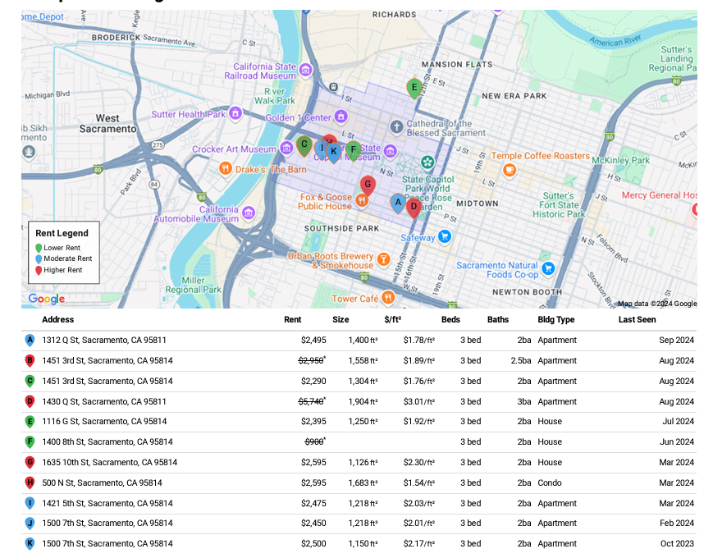

Slide 5
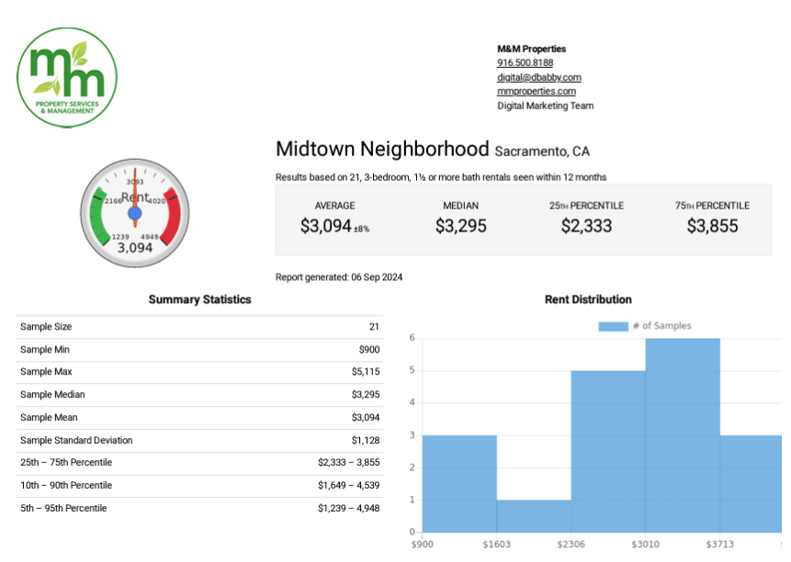

Slide 6
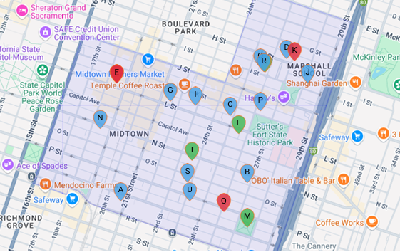
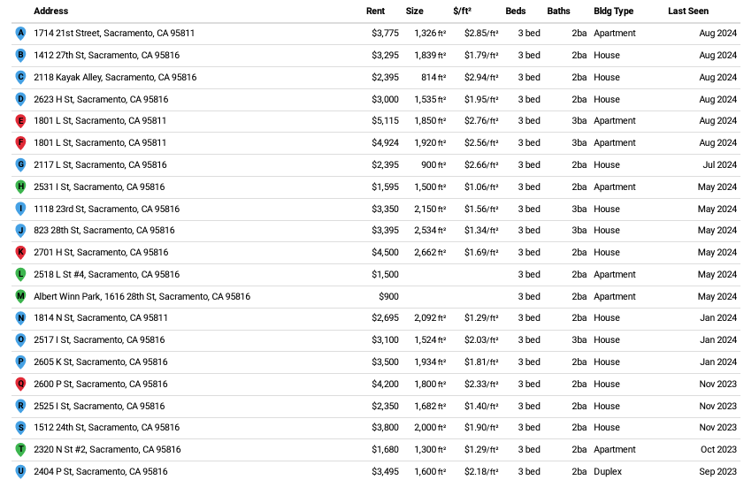

Slide 7
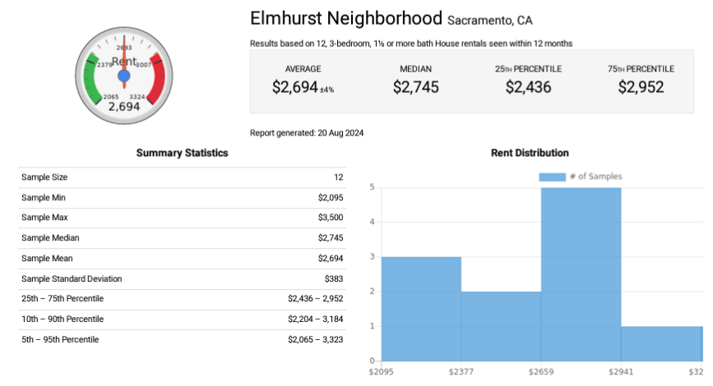

Slide 8
