Slide 1
Rental Market Trends for Sacramento, CA
Data from rent.com

Slide 2
Data from rent.com

Slide 3
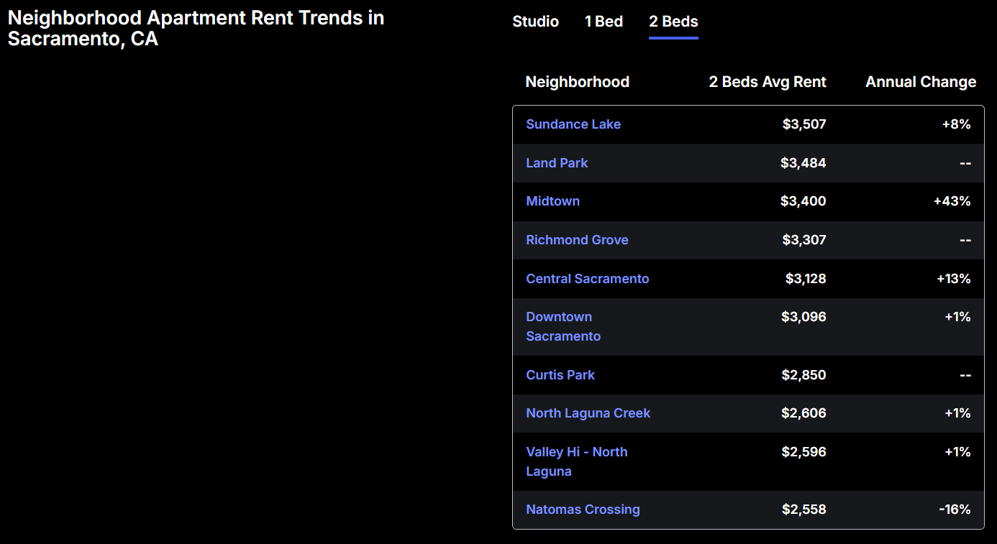
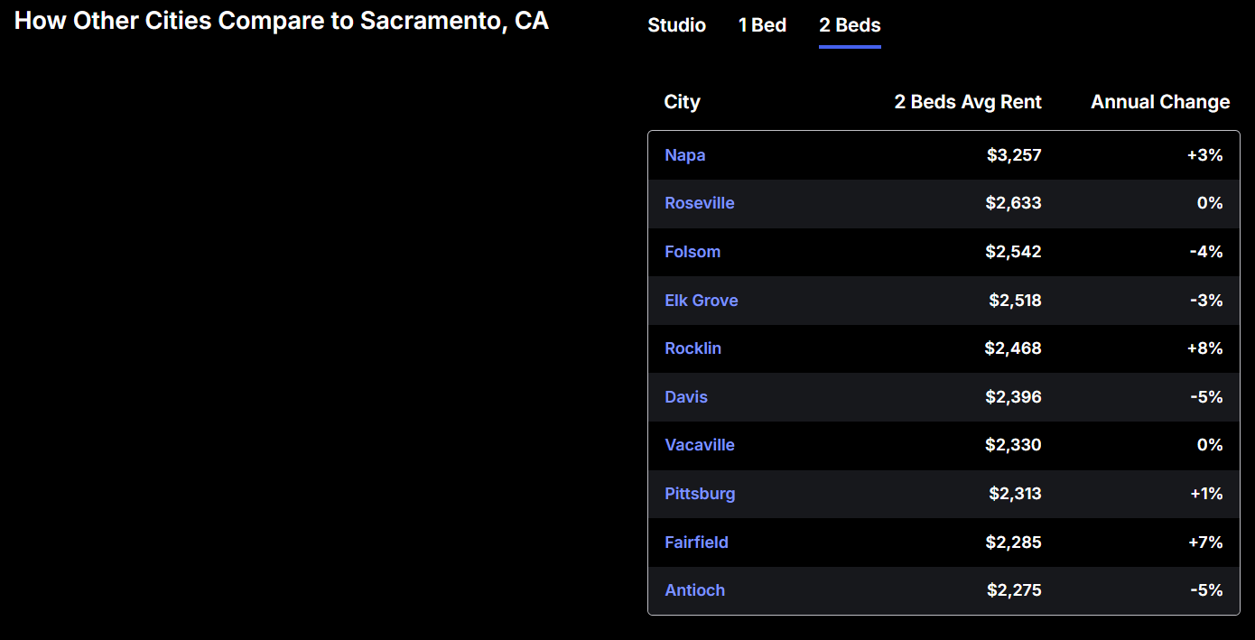
Data from rent.com

Slide 4
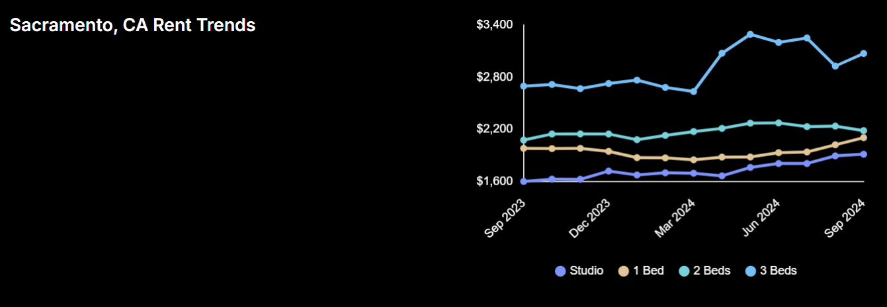
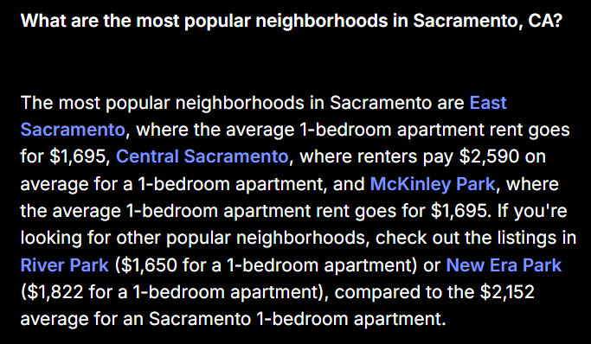
Data from rent.com

