Slide 1


Sacramento, CA Rental Market
Nov 2024
Data provided by: Zillow

Slide 2

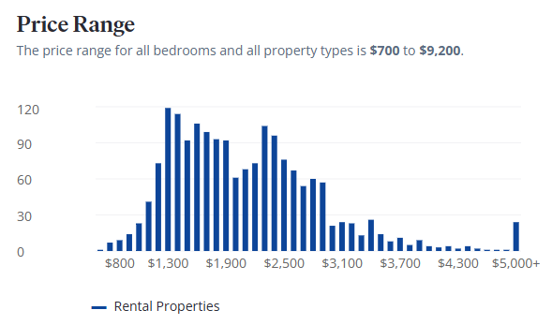
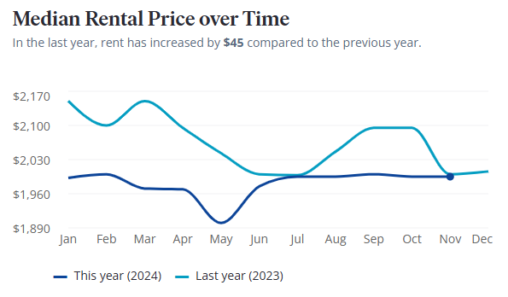
Data provided by: Zillow

Slide 3
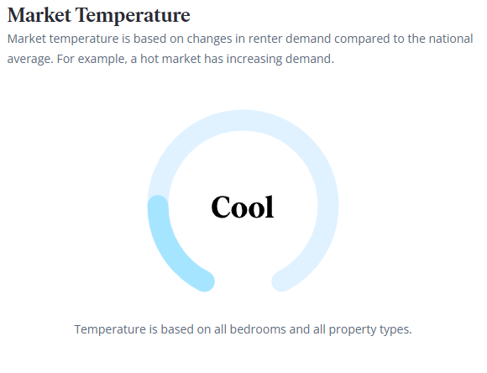
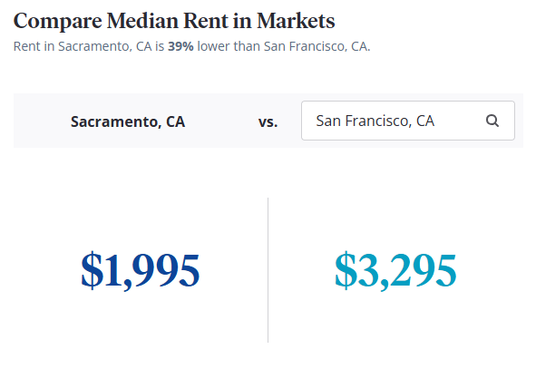

Data provided by: Zillow

Slide 4
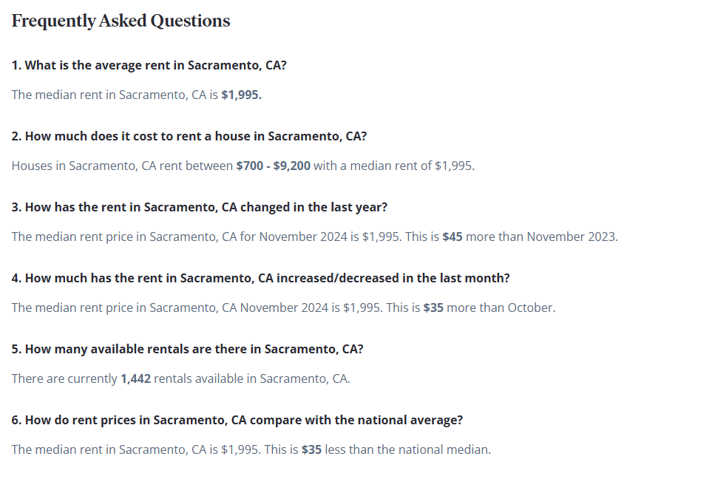
Data provided by: Zillow

