Slide 1



Looking Back 2024
Looking Forward 2025

Slide 2
Sacramento Rental Market 2024
The Sacramento rental market in 2024 has been characterized by steady growth, though at a more moderate pace compared to previous years. This reflects a maturing market with a balance between strong demand and a gradual increase in supply.
Rent Growth
Rents have continued to rise throughout the year, but the rate of increase has slowed down. This moderation suggests a more balanced market where demand remains robust, but drastic price hikes have been mitigated.
Vacancy Rates
Vacancy rates have remained relatively low, indicating persistent demand for rental housing in Sacramento. This tight market has kept competition high for renters.
Factors Influencing the Market
  Strong Job Market: Sacramento's growing economy and job market have continued to attract new residents, fueling demand for rental housing.
  Limited Supply: While new construction projects are underway, the pace of development has not kept up with the increasing demand, contributing to limited housing availability.
  Economic Conditions: The overall economic climate has played a role, with factors like inflation and interest rates influencing both renter demand and the cost of housing.
M&M Properties | 1545 River Park Drive #100 | Sacramento | 95815 | 916.500.8188

Slide 3
Sacramento Rental Market Forecast 2025
Forecasting the Sacramento rental market for 2025 involves considering several key factors
Continued Demand: The strong job market and overall economic growth in Sacramento are expected to continue driving demand for rental housing.
Increased Supply: New construction projects currently underway are expected to gradually increase the supply of rental units, which could help to stabilize the market and potentially moderate rent growth.
Economic Uncertainty: The potential impact of economic factors like inflation, interest rates, and a potential recession could influence renter behavior and overall market stability.
Potential Market Scenarios
Scenario 1: Moderate Growth
Assumptions: Continued economic growth, gradual increase in supply, and manageable inflation.
  Outcome: Rents are expected to continue to rise, but at a moderate pace. Vacancy rates may gradually increase, but remain relatively low.
Scenario 2: Slower Growth
  Assumptions: Economic slowdown, potential recession, and limited new construction.
  Outcome: Rent growth may slow down or even stabilize. Vacancy rates could potentially increase, but the overall market is likely to remain competitive.
M&M Properties | 1545 River Park Drive #100 | Sacramento | 95815 | 916.500.8188

Slide 4
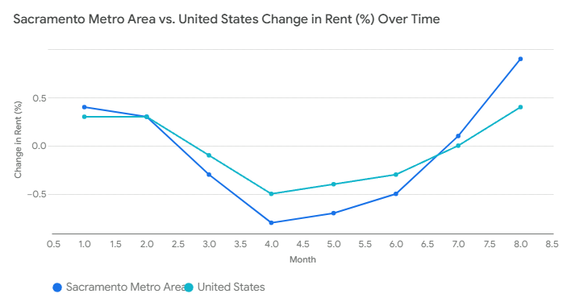
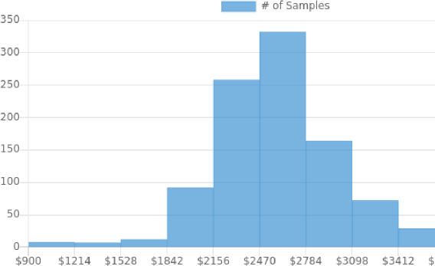
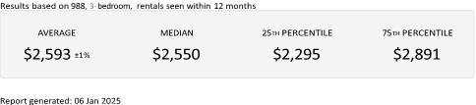
M&M Properties | 1545 River Park Drive #100 | Sacramento | 95815 | 916.500.8188

