Slide 1

M&M Properties
What neighborhoods in Sacramento offer the best value for renters?

Slide 2
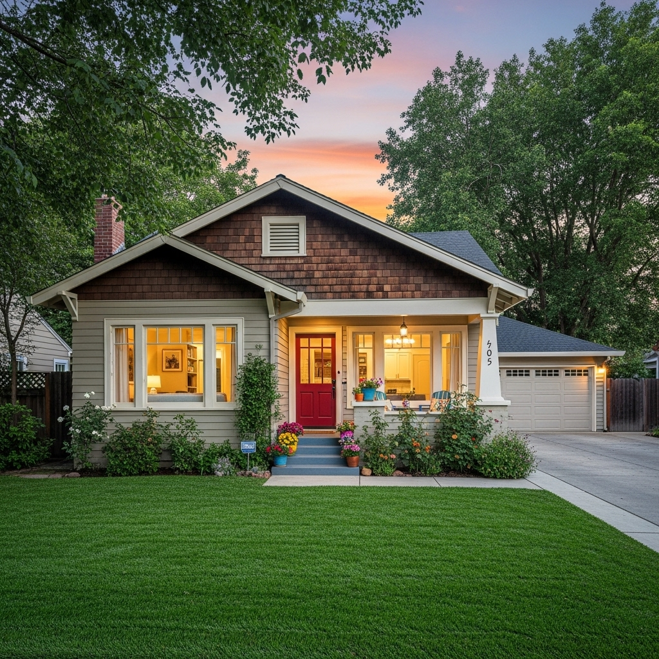
Several Sacramento neighborhoods stand out for offering the best value for renters, balancing affordability, amenities, safety, and access to the city’s highlights. Based on the latest data for 2025, here are the top value neighborhoods for renters in Sacramento:
College-Glen Tahoe Park
South Natomas River Park
Parkway Estates Natomas Park
South Land Park Rosemont

Slide 3
Best Value Neighborhoods for Renters in Sacramento
College –Glen
Average rent: $1,761 (as of February 2025)
Features: Tree-lined streets, proximity to the American River Parkway, reliable public transportation, and a peaceful suburban atmosphere close to downtown.
Why it’s a value: Offers a strong sense of community and outdoor amenities at a reasonable price.
South Natomas
Average rent: $1,798
Features: Easy access to downtown, abundant parks (like Discovery Park), shopping, dining, and proximity to major employers and the airport.
Why it’s a value: Urban convenience with a relaxed residential feel, making it ideal for professionals and frequent travelers.

Slide 4
Best Value Neighborhoods for Renters in Sacramento
Parkway Estate
Average rent: $1,641
Features: Wide streets, large yards, a down-to-earth community, and good access to highways and public transit.
Why it’s a value: One of the lowest average rents in the city, great for families and commuters seeking affordability without sacrificing city access.
South Land Park
Average rent: $1,742
Features: Known for mid-century homes, walkable streets, proximity to William Land Park (zoo, golf), and local dining.
Why it’s a value: Classic Sacramento charm and amenities at a budget-friendly price.

Slide 5
Best Value Neighborhoods for Renters in Sacramento
Rosemont
Average rent: $1,774
Features: Suburban comfort, easy access to downtown via Highway 50 or light rail, plenty of green space, and local shops.
Why it’s a value: Quiet, family-friendly, and well-connected to the city core.
Natomas Park
Median rent: $1,989
Features: Walkable, safe (safer than 82% of Sacramento neighborhoods), parks, shopping centers, and good schools.
Why it’s a value: Strong community feel, safety, and amenities for families and professionals.

Slide 6
Best Value Neighborhoods for Renters in Sacramento
River Park
Median rent: $1,514
Features: Craftsman-style homes, excellent schools, very safe (safer than 91% of Sacramento neighborhoods), and close to downtown.
Why it’s a value: One of the safest and most affordable neighborhoods with great community events and river access.
Tahoe Park
Median rent: $1,552
Features: Friendly atmosphere, proximity to UC Davis Medical Center, good schools, and easy commuting.
Why it’s a value: Affordable, safe, and ideal for young professionals and families.

Slide 7
Neighborhood | Avg./Median Rent | Key Advantages
College-Glen | $1,761 | Suburban, parks, close to downtown
South Natomas | $1,798 | Urban access, parks, airport nearby
Parkway Estates | $1,641 | Lowest rent, family-friendly
South Land Park | $1,742 | Classic homes, parks, walkable
Rosemont | $1,774 | Suburban, green space, transit access
Natomas Park | $1,989 | Safe, walkable, community amenities
River Park | $1,514 | Very safe, schools, river access
Tahoe Park | $1,552 | Safe, schools, near UC Davis Med Center

Slide 8
Best Value Neighborhoods for Renters in Sacramento
Additional Mentions
Carmichael (just outside city limits) is also noted as a relatively affordable and nice area, though slightly farther from central Sacramento.
Oak Park is emerging as a trendy, affordable option with improving safety and proximity to downtown, though it may not yet match the safety profile of the neighborhoods above.
Conclusion
For renters seeking the best value in Sacramento, neighborhoods like College-Glen, Parkway Estates, River Park, Tahoe Park, and South Natomas consistently offer a compelling mix of affordability, amenities, and quality of life. These areas provide access to parks, schools, and transit while maintaining reasonable rents, making them standout choices for budget-conscious renters in 2025

