Slide 1
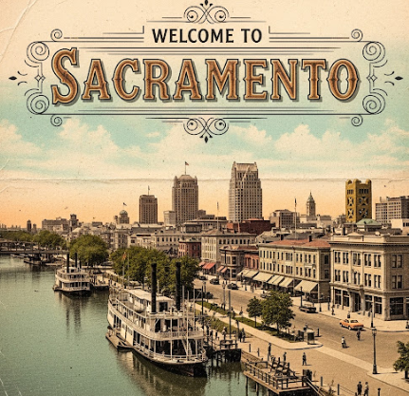
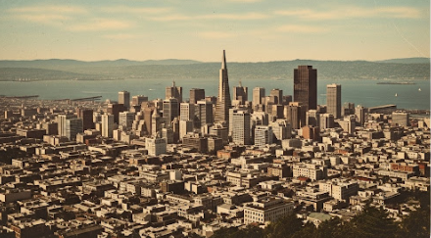
Sacramento vs. San Francisco
“Mid-Summer Showdown”
Winner is ???

Slide 2
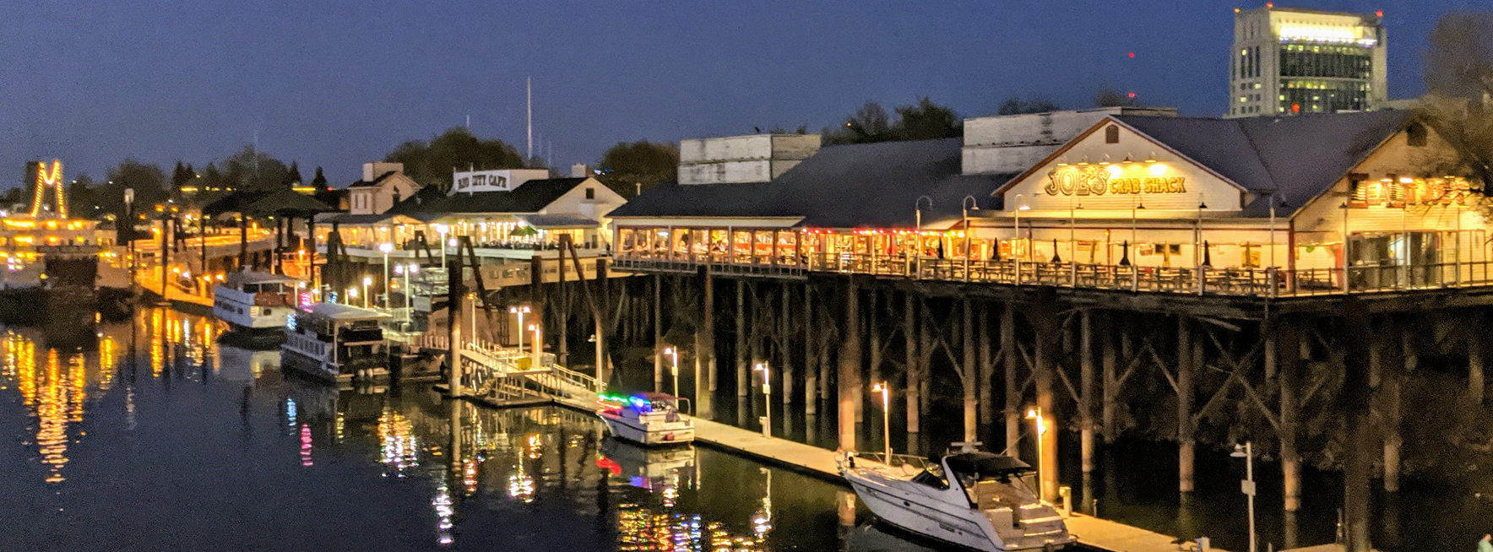
As the summer sun blazes, many Californians are drawn to the vibrant city life and outdoor adventures the state has to offer. But when it comes to Sacramento and San Francisco, which city truly shines in the golden state? Let's dive into a mid-summer comparison, looking at quality of life, farm produce, and the restaurant scene.
Quality of Life
Sacramento:
Sacramento offers a quality of life that appeals to many, particularly those seeking a more affordable and relaxed lifestyle compared to other major California cities like San Francisco. Sacramento offers a compelling blend of affordability, job opportunities, a vibrant food scene, and access to extensive outdoor recreation. While it has its challenges, many residents find it a desirable place to live, especially when compared to the higher costs and faster pace of other major California cities.

Slide 3
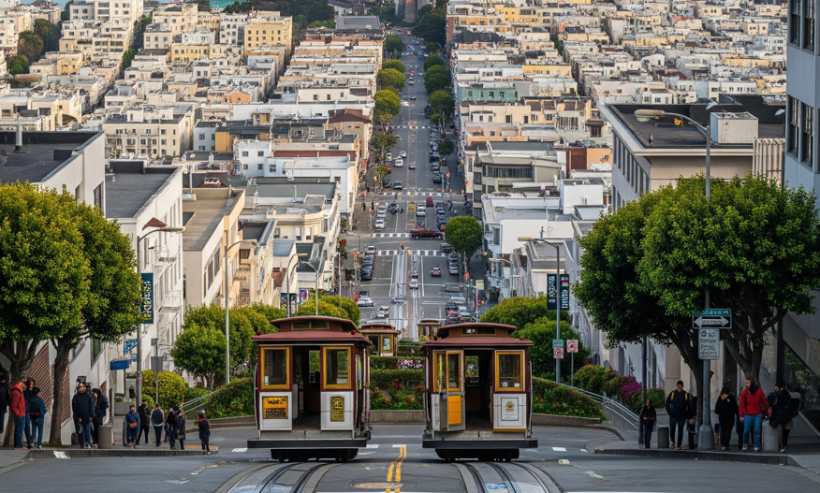
Quality of Life
San Francisco:
San Francisco offers a truly unique urban experience with its iconic landmarks, diverse neighborhoods, and stunning bay views. The city boasts a thriving tech industry, world-class cultural institutions, and a strong emphasis on outdoor activities, from hiking in the Marin Headlands to cycling along the Golden Gate Bridge. While the cost of living is notably higher, many residents find the unparalleled opportunities and vibrant atmosphere worth the investment. The city's commitment to public transportation, walkable streets, and a strong sense of community contribute to a dynamic and engaging lifestyle.

Slide 4
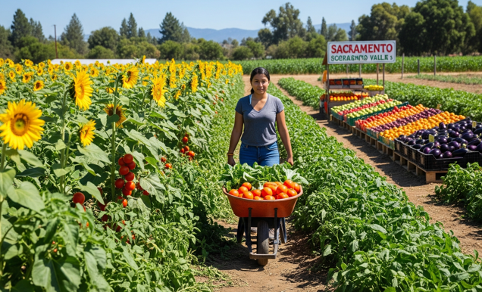
Farm Produce
Sacramento:
Sacramento, nestled in the heart of the fertile Central Valley, is often called the "Farm-to-Fork Capital." This region boasts an incredible abundance of fresh, locally grown produce. From the vibrant farmers' markets bursting with seasonal fruits and vegetables to the direct relationships many restaurants have with local farms, the emphasis on fresh, sustainable ingredients is undeniable. Residents enjoy unparalleled access to everything from juicy peaches and sweet corn in the summer to crisp apples and leafy greens in the fall. The proximity to agricultural lands means produce often travels mere miles from farm to table, ensuring peak freshness and flavor.

Slide 5
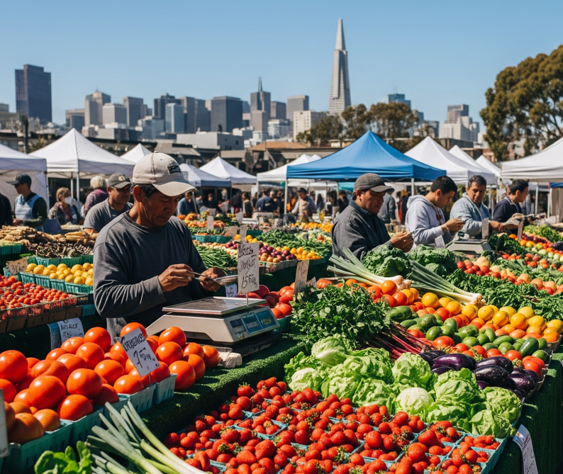
Farm Produce
San Francisco:
San Francisco, while not directly surrounded by agricultural land like Sacramento, benefits from its proximity to various fertile regions in Northern California. The city's numerous farmers' markets, such as the renowned Ferry Building Marketplace, offer a fantastic selection of fresh, seasonal produce sourced from farms within a reasonable distance. These markets are a hub for food enthusiasts, providing access to organic produce, artisanal goods, and a direct connection with local farmers. Many of San Francisco's restaurants also prioritize farm-to-table practices, forging relationships with regional growers to bring the freshest ingredients to their menus.

Slide 6
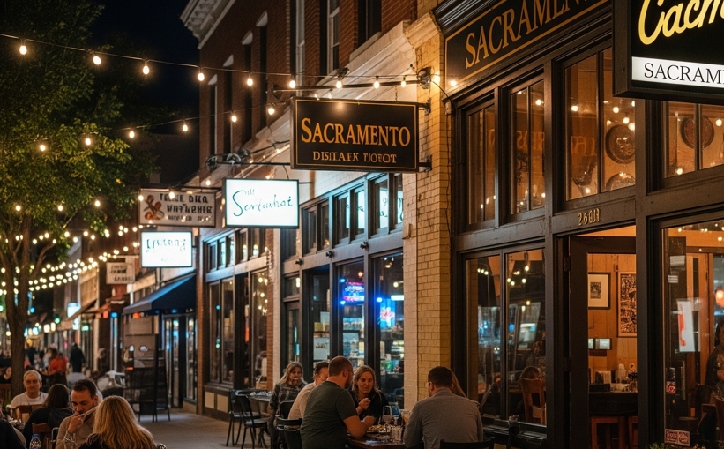
Restaurant Scene
Sacramento:
Sacramento's culinary scene has truly blossomed in recent years, heavily influenced by its "Farm-to-Fork" identity. The city offers a diverse array of dining experiences, from upscale farm-to-table establishments that highlight seasonal, local ingredients to casual eateries serving up innovative and globally inspired dishes. Old Sacramento and Midtown are vibrant hubs for dining, with options ranging from trendy gastropubs to authentic ethnic cuisine. The emphasis on fresh, locally sourced ingredients means that even casual dining often boasts a superior level of flavor and quality.

Slide 7
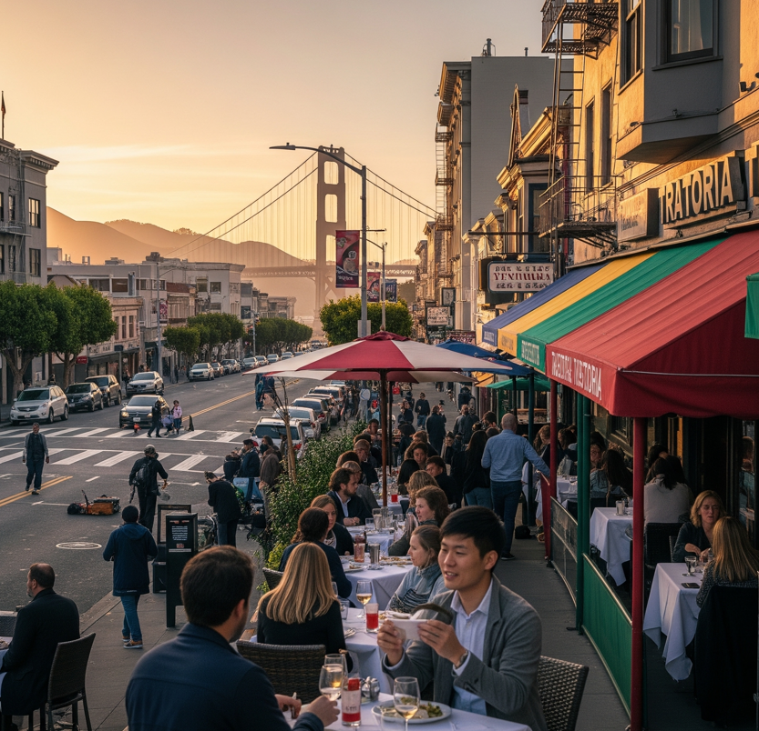
Restaurant Scene
San Francisco:
San Francisco's restaurant scene is world-renowned for its innovation, diversity, and Michelin-starred establishments. From the gourmet offerings in the Mission District to the fresh seafood at Fisherman's Wharf, the city caters to every palate. San Francisco is a melting pot of culinary influences, with neighborhoods specializing in various cuisines, including vibrant dim sum in Chinatown, authentic Italian in North Beach, and cutting-edge fusion in SoMa. The city's strong food culture also embraces sustainable practices, with many restaurants sourcing ingredients from local farms and purveyors. Whether you're seeking a casual bite or a fine dining experience, San Francisco's restaurant scene offers an unforgettable gastronomic journey.

Slide 8
The WINNER Sacrament (2) Vs. San Francisco (1)
Sacramento often offers a compelling proposition for a higher quality of life, primarily driven by its more accessible cost of living, particularly in housing, when compared to San Francisco. This affordability allows for a more relaxed pace of life and a greater sense of financial ease for many residents.
When it comes to farm produce, Sacramento stands as the undisputed champion. Nestled in the heart of California's fertile Central Valley, it boasts direct and unparalleled access to an abundance of fresh, locally grown fruits, vegetables, and other agricultural products. This proximity to farms means produce travels fewer miles from field to table, resulting in fresher, more flavorful ingredients. San Francisco, while having excellent farmers' markets, relies on sourcing from surrounding agricultural regions, which can't quite match Sacramento's immediate farm-to-fork connection.
Regarding the restaurant scene, while San Francisco has long held a global reputation for its culinary innovation and Michelin-starred establishments, Sacramento has made truly remarkable strides in the past decade. Just ten years ago, Sacramento's dining landscape, while having its gems, was often seen as lagging behind its more glamorous Bay Area counterpart. However, thanks to a burgeoning "Farm-to-Fork" movement that leverages its agricultural bounty, Sacramento's food scene has exploded. The city now boasts a diverse and vibrant array of restaurants, from fine dining establishments to innovative casual eateries, all prioritizing fresh, local ingredients. This transformation represents a significant improvement, establishing Sacramento as a legitimate and exciting culinary destination in its own right, no longer merely living in San Francisco's shadow.

